Slide 1

NAME : Aavani Rajesh Perumbessi
Cohort : Mark Zuckerberg
Roll no : 1500
Assessment 3

Slide 2


VOLUME
1
VARIETY
2
VELOCITY
3
5 V’s of data
Brocelle App
VARACITY
4
VALUE
5

Slide 3
It refers to the massive amount of data generated every second.
Includes data from sources like social media, IoT, e-commerce, and sensors.
Measured in terabytes, petabytes, or even zettabytes.
Requires scalable storage systems like Hadoop or cloud solutions.
Challenges involve storing, accessing, and processing vast datasets.
Data warehouses and data lakes are common solutions.
Enables analysis on a larger scale for deeper insights.
VOLUME

Slide 4
It represents the different forms and formats of data.
Includes structured (databases), semi-structured (XML, JSON), and unstructured data (videos, emails).
Sources range from social media posts to IoT devices and financial systems.
Diverse formats make integration and analysis complex.
Requires tools like NoSQL databases and data transformation platforms.
Each data type provides unique value when analyzed correctly.
VARIETY

Slide 5
It refers to the speed at which data is created and processed.
Examples include stock market transactions, streaming data, and real-time monitoring.
Requires real-time or near real-time analytics for actionable decisions.
Technologies like Apache Kafka and Spark Streaming manage high-speed data.
Delay in processing velocity data can lead to missed opportunities.
Critical for applications like fraud detection and live recommendations.
VELOCITY

Slide 6
It refers to the accuracy and trustworthiness of data.
Data may be inconsistent, incomplete, or biased.
Poor data quality can lead to incorrect conclusions or decisions.
Requires processes like data cleaning, validation, and enrichment.
Includes addressing noise, duplication, and outdated information.
Confidence in data builds better predictive models and insights.
VERACITY

Slide 7
It represents the insights and benefits derived from analyzing data.
Data alone is not useful unless it creates measurable impact.
Helps optimize business processes, improve customer experiences, and drive innovation.
Examples include cost reduction, revenue growth, and predictive analytics.
Requires clear objectives and tools for meaningful analysis.
VALUE

Slide 8
PURPOSE
1
1
PROGRAMMABILITY
2
PLATFORM
3
5 P’s of data
Brocelle App
PROCESS
4
PEOPLE
5

Slide 9
Data should serve a specific goal or objective.
Clearly define why the data is being collected and analyzed.
Aligns data initiatives with business outcomes.
Examples: improving customer satisfaction, optimizing processes, or reducing costs.
Ensures resources are focused on meaningful activities.
Avoids collecting irrelevant or excessive data.
Drives strategic decision-making through actionable insights.
PURPOSE

Slide 10
Refers to the ability to automate and manipulate data workflows.
Involves using programming languages like Python, R, or SQL.
Enables custom data pipelines, analytics, and machine learning models.
Facilitates real-time data processing and automation of repetitive tasks.
Allows integration with APIs and other data systems for dynamic operations.
Provides flexibility to adapt tools and algorithms to specific needs.
PROGRAMMABILITY

Slide 11
The infrastructure or ecosystem used to store, process, and analyze data.
Examples include cloud platforms (AWS, Azure, Google Cloud) and on-premises systems.
Supports data integration, analytics, and visualization.
Must be scalable to handle growing data volumes and complexity.
Ensures security, compliance, and accessibility of data.
Provides tools for managing structured, semi-structured, and unstructured data.
PLATFORM

Slide 12
Refers to the steps taken to manage data from collection to insight generation.
Includes data collection, cleaning, transformation, analysis, and reporting.
Follows best practices like ETL (Extract, Transform, Load) for data pipelines.
Ensures data quality and consistency through governance frameworks.
Streamlines workflows to reduce inefficiencies and delays.
Involves continuous monitoring and improvement of data processes.
PROCESS

Slide 13
It represents the human element in managing and utilizing data effectively.
Includes data engineers, analysts, scientists, and business stakeholders.
Requires a mix of technical expertise and domain knowledge.
Fosters a data-driven culture within the organization.
Encourages collaboration across departments for shared insights.
Training and upskilling are essential to keep up with evolving technologies.
PEOPLE

Slide 14

No code is a development method designed for individual capabilities besides enabling them to develop applications, websites, or automate workflows without writing any programming code. It depends on visual interfaces, drag and drop tools, and pre-built templates as these serve important purposes in giving it easier for non-technical users to build and deploy solutions.
Instead of programming, users of no-code platforms create software by arranging components like forms, buttons, or workflows. This cuts development time drastically, allowing businesses to innovate faster.
What do you understand by No code

Slide 15
Accessibility-permitting the non-technical users to build applications irrespective of their programming skills.
Speed- Enhances the speed of development by drag and drop tools and pre-made templates.
Cost effective- Less need to hire developers hence reducing project costs.
Flexibility-Easily adjust applications in line with changing requirements.
Empowerment- Business end users can independently create and manage the software.
Prototyping- Rapid development of prototypes or MVPs (minimum viable products) for experimentation of the ideas.
Integration: Linking or combining with other tools or systems (e.g., APIs, databases).
ADVANTAGES

Slide 16
Customization is Limited: compared to normal coding, it has less flexibility.
Scalability Restriction: probably will not handle a huge application or a complex one.
Vendor Lock-in: The no-code platform dependence; it becomes difficult to transfer from one provider to another.
Security Issues: dependent on platform security, which has some security gaps.
Constricted Performance: may not have the cuts for higher-level applications.
Lack of Ownership: No user has full ownership of the behind code and infrastructure.
Learning Curve: Users may still need training for complicated tasks, though it is easier than coding.
DISADVANTAGES

Slide 17
Drag and Drop Design: With visual tools, everyone can build with applications.
Pre-built Template: Faster development with ready-made designs and workflows.
Cloud Hosting: Applications are hosted and run on the platform's server.
Cross-platform Compatible: Creates applications for any environment on the web, mobile, or desktop.
Integration tools: Connecting external APIs, databases, or services like Zapier.
Real-time collaboration: All teams members can collaborate on projects.
These include customizable forms, charts, buttons, and so on used for adapting to critical needs.
FEATURES

Slide 18
Common No-Code Platforms:
Wix
Google sheets
Bubble
Webflow
Zapier
Airtable
Glide
Shopify
Adalo
Grapher
ESSENTIALS
Brocelle App

Slide 19
Wix is an online website builder that helps you create websites without needing to know any coding. It also has a drag-and-drop editor that gives you ease to design and customize your website using ready template designs. You can add just about anything from text, images, and buttons to personalize your pages. Wix also includes hosting and connects any custom domain to your website. Calculate also for SEO and e-commerce (for online shops) and provide third-party app integration to your website for added functions. This is probably the best website builder for business, blogs, portfolios, or personal sites, putting website creation to use for just about anyone.
WIX

Slide 20
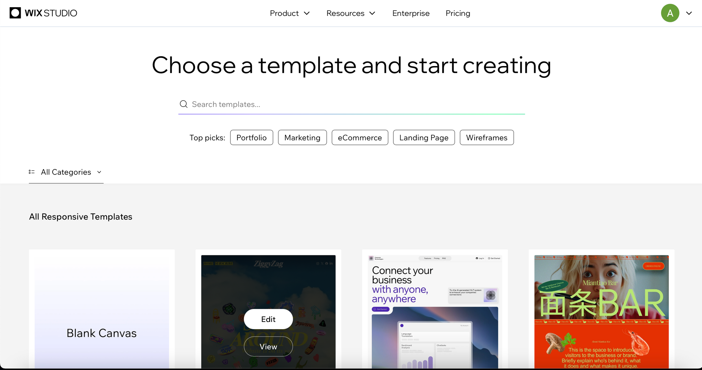

Slide 21
It allows real-time collaboration between users so that they can create, edit, and share spreadsheets using Google Sheets in a cloud-based fashion. Like Excel, it supports the basic elements of a spreadsheet, but because it is entirely online, the sharing and collaboration aspect is made significant. Users can enter data, perform computations, and create graphics such as charts and graphs. It's also a useful spreadsheet program that supports things like formulas, pivot tables, or data validation. Because it is closely integrated with other Google Workspace tools like Google Docs, Forms, and Drive, it is also really versatile. It allows real-time collaboration, stores everything automatically, and can be accessed by any connected device. Thus, it is best suited for group-related projects and management of their data.
Google Sheets

Slide 22
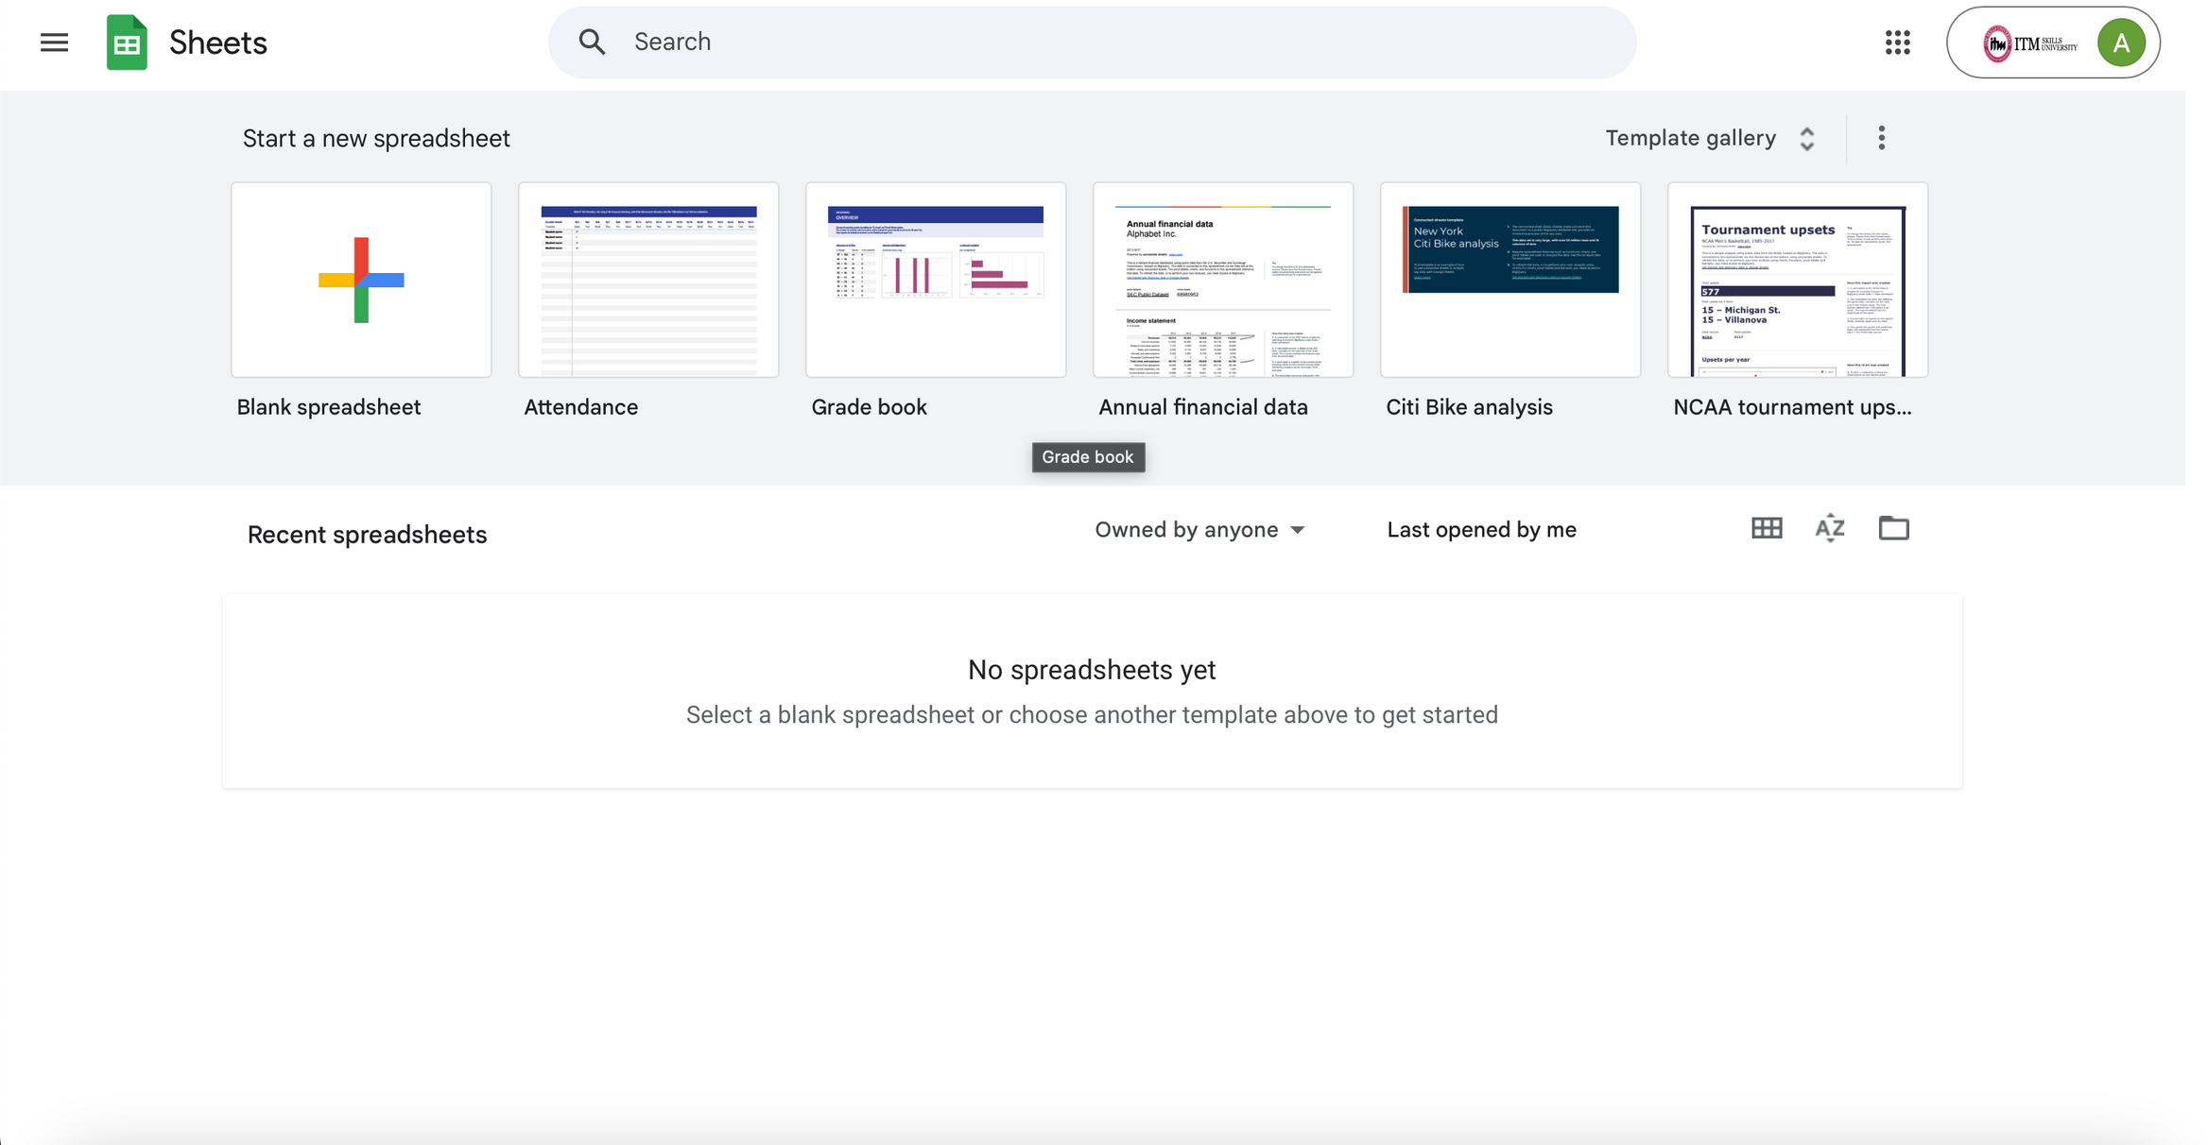

Slide 23
Bubbles build no-code applications, and it is fully functional web applications built through their interface without writing a single code. Visual editor all-works together to build interfaces, workflows, and databases. One can create truly dynamic applications such as social networks, marketplaces, or CRM systems from scratch using nothing but drag-and-drop elements. Backed by Bubble, also has backend logic support to such users in managing data, executing actions, and relying on external APIs. Bubble turns businesses and individuals into seriously charging products in record time and at very cheap expense without the need for a development team.
es.
BUBBLE

Slide 24
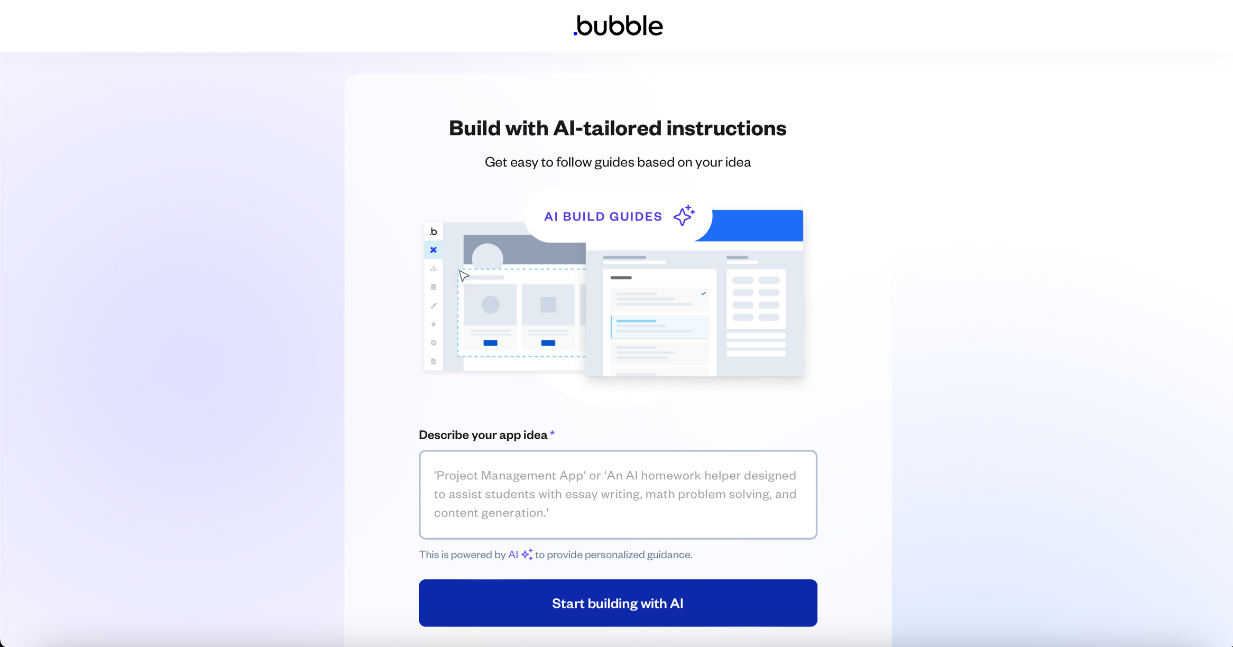

Slide 25
With Webflow, you can create responsive websites using no code. The interface allows users to drag and drop design elements while providing even more advanced design tools to create completely customized websites no coding required. Webflow is also a full solution for dynamic websites and online stores, with hosting, a CMS, and e-commerce. It can be used by beginners and experienced designers who want some level of control over their design and functionality.
WEB FLOW

Slide 26
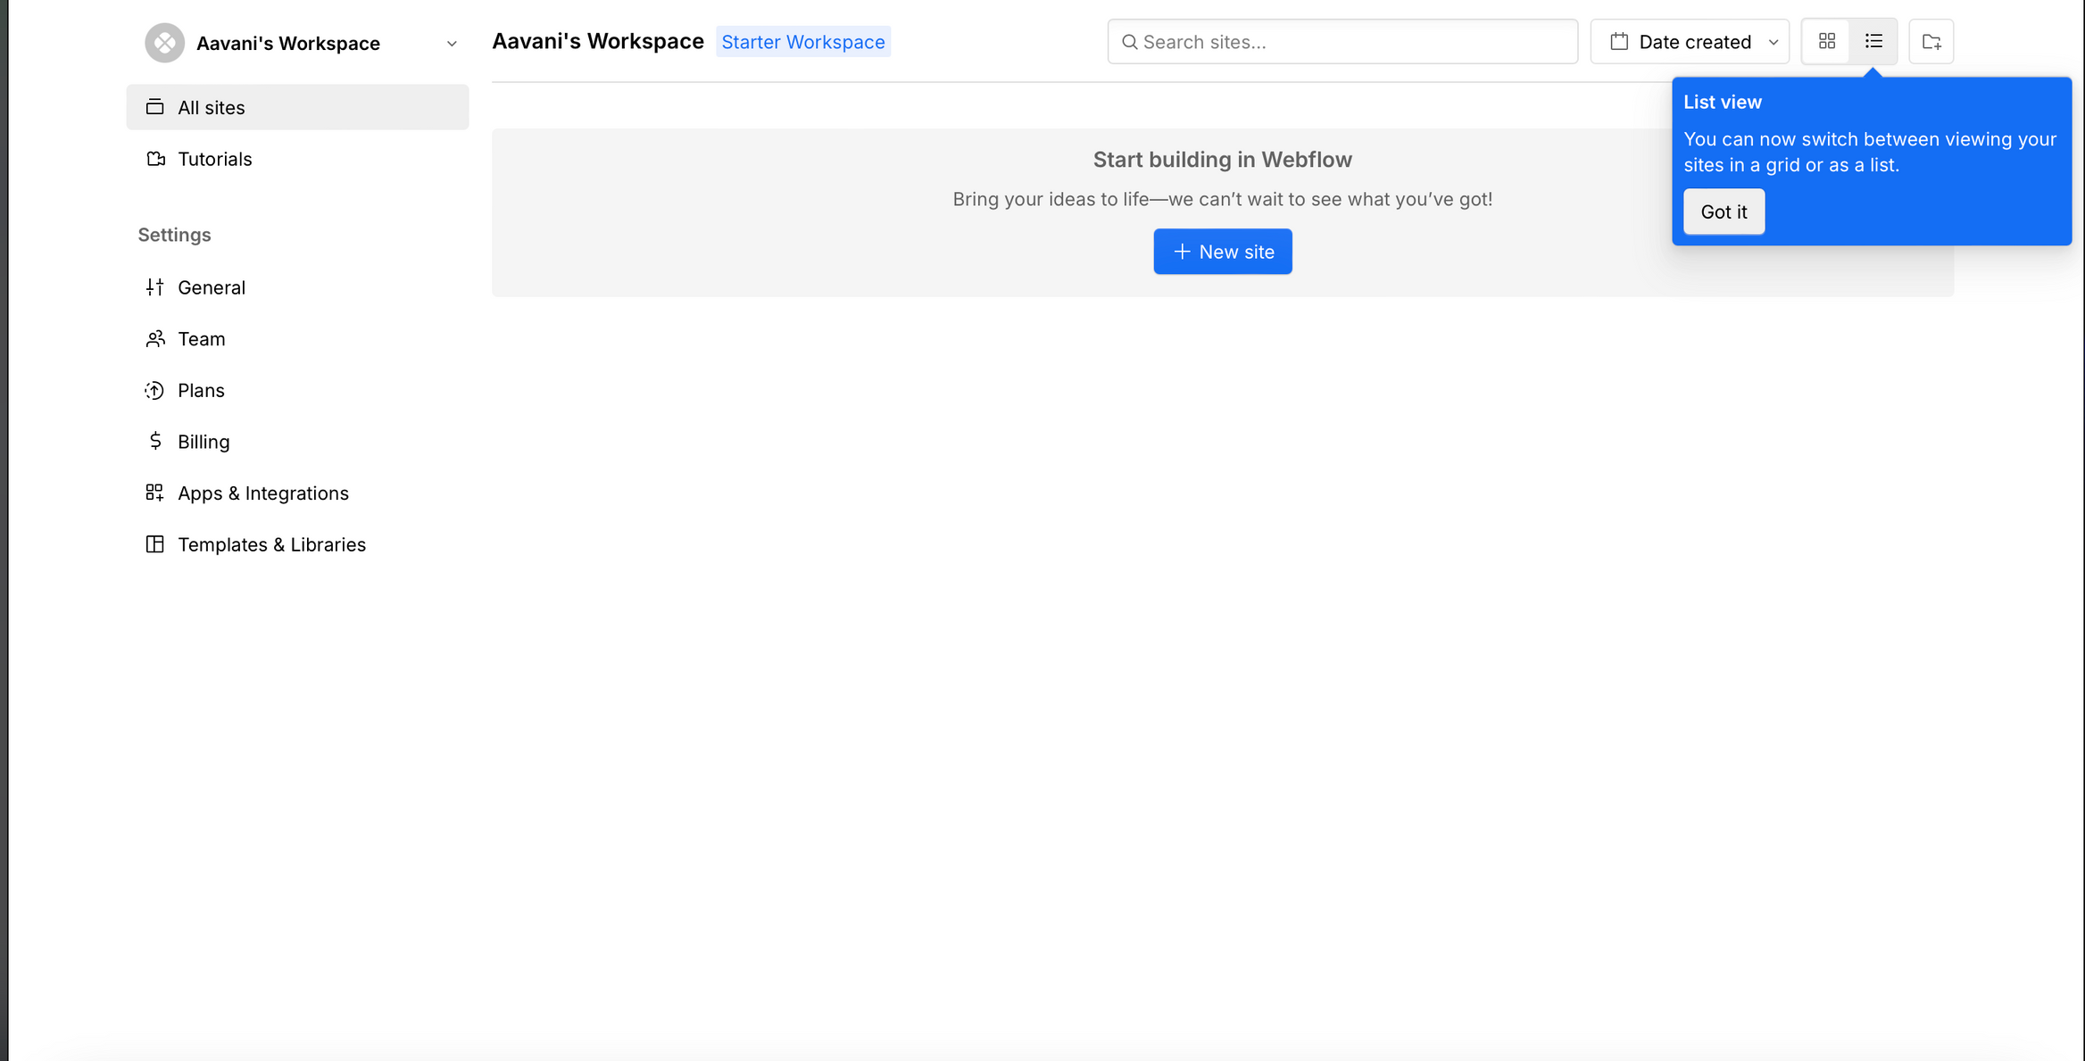

Slide 27
This allows a user to create a so-called "Zap". A "Zap" is defined as an automated workflow where an action in app A triggers an event in app B. For example, a new email can automatically add the sender as a contact in a CRM. Zapier has built-in integration with more than 5,000 other apps, including Gmail, Slack, and Google Sheets. This makes Zapier an incredible timesaver by removing so many boring tasks.
ZAPIER

Slide 28
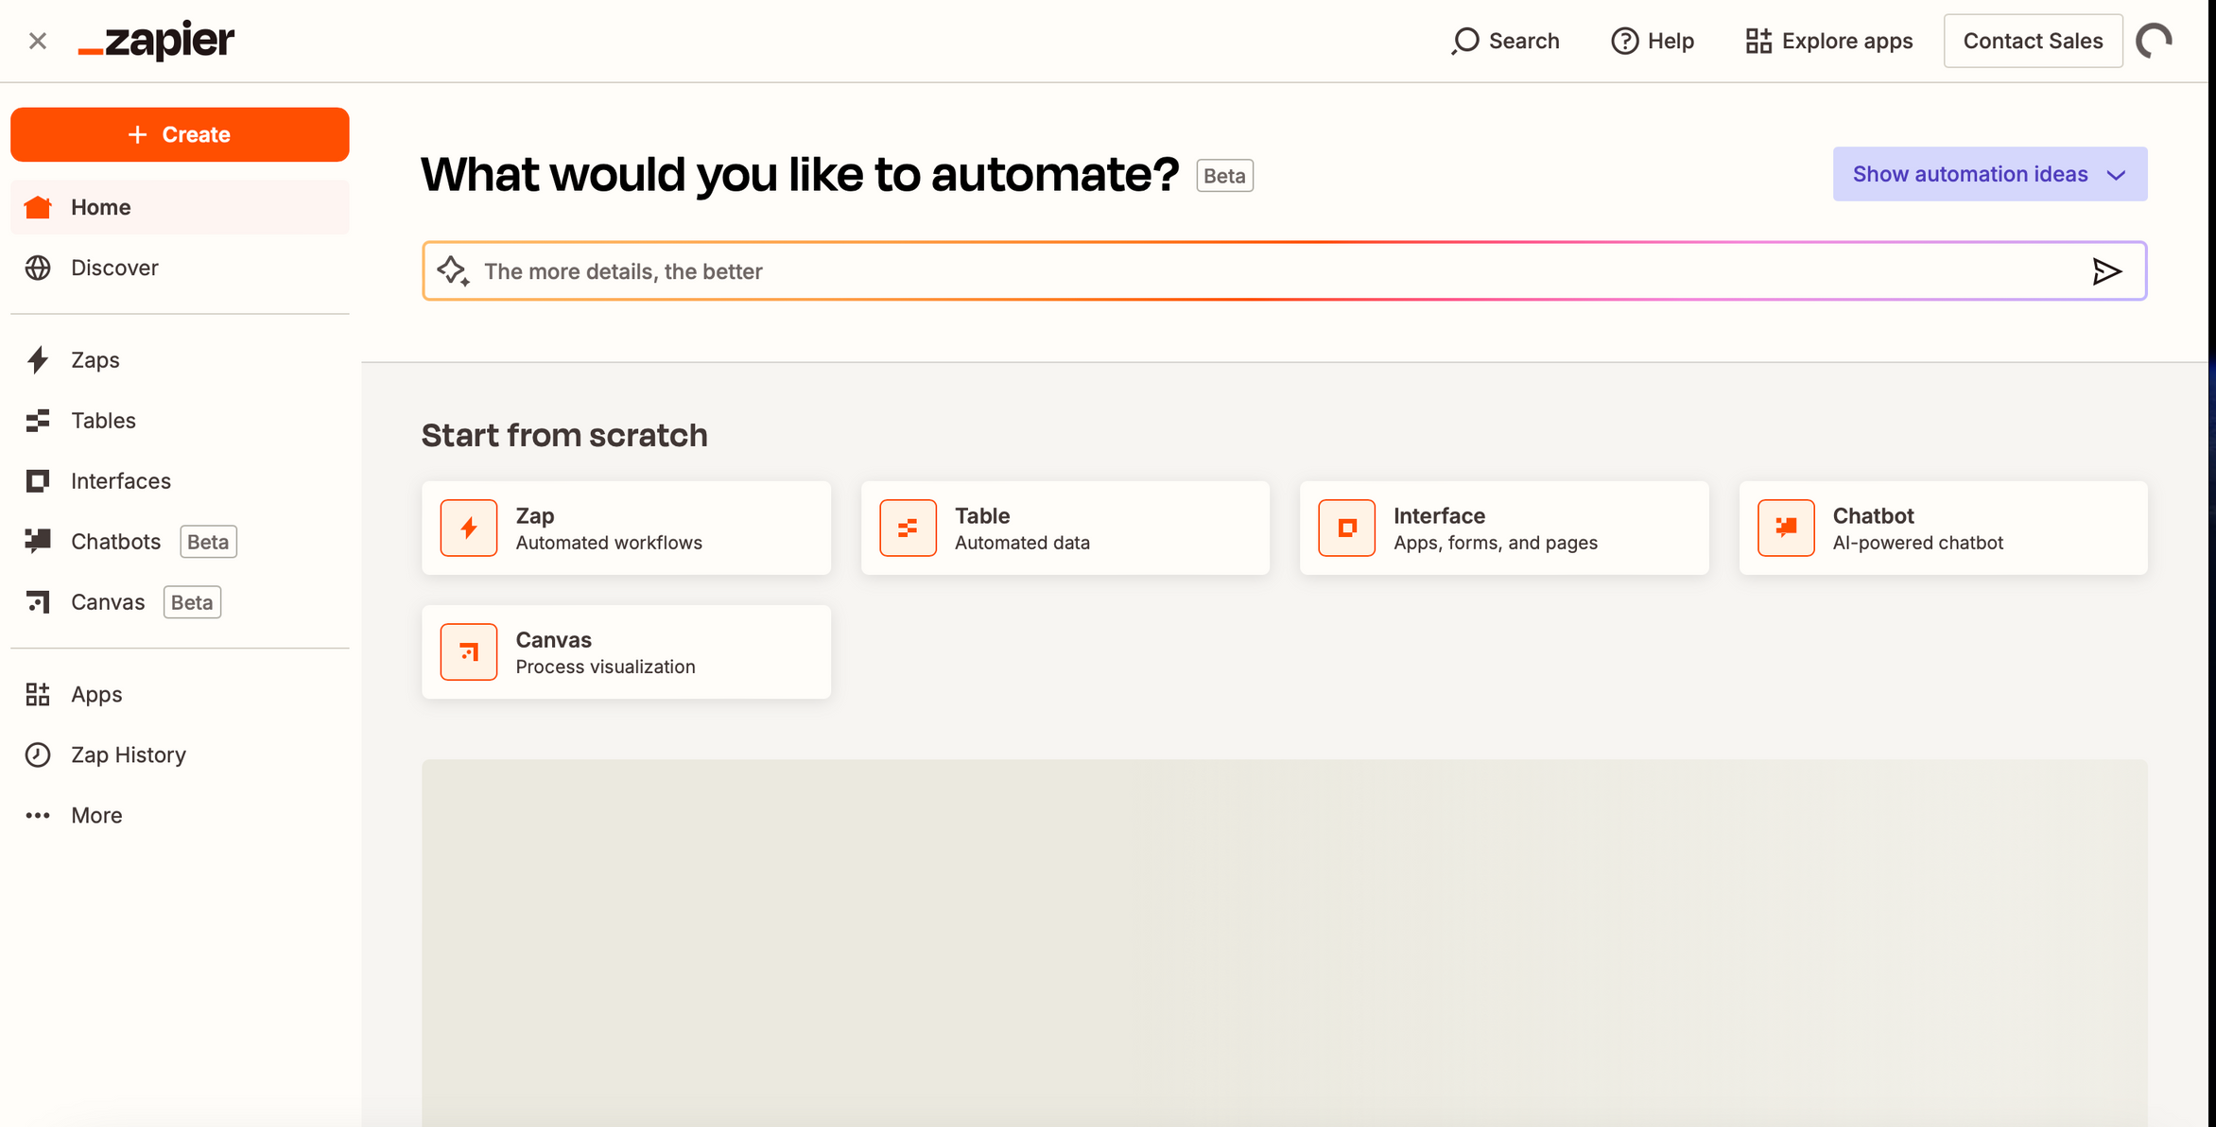

Slide 29
Simple spreadsheet interface with powerful database functionality - that's no code Airtable for you. With customizable tables, views, and fields for data organization, tracking, and collaboration, it works with diverse modalities of data - text, images, attachments-for project management and CRM capabilities and has even more. It supports all these and many other functions with integrated capabilities into various external applications, making it a very adaptable solution for organizing workflows, managing teams, and automating tasks.
AIR TABLE

Slide 30
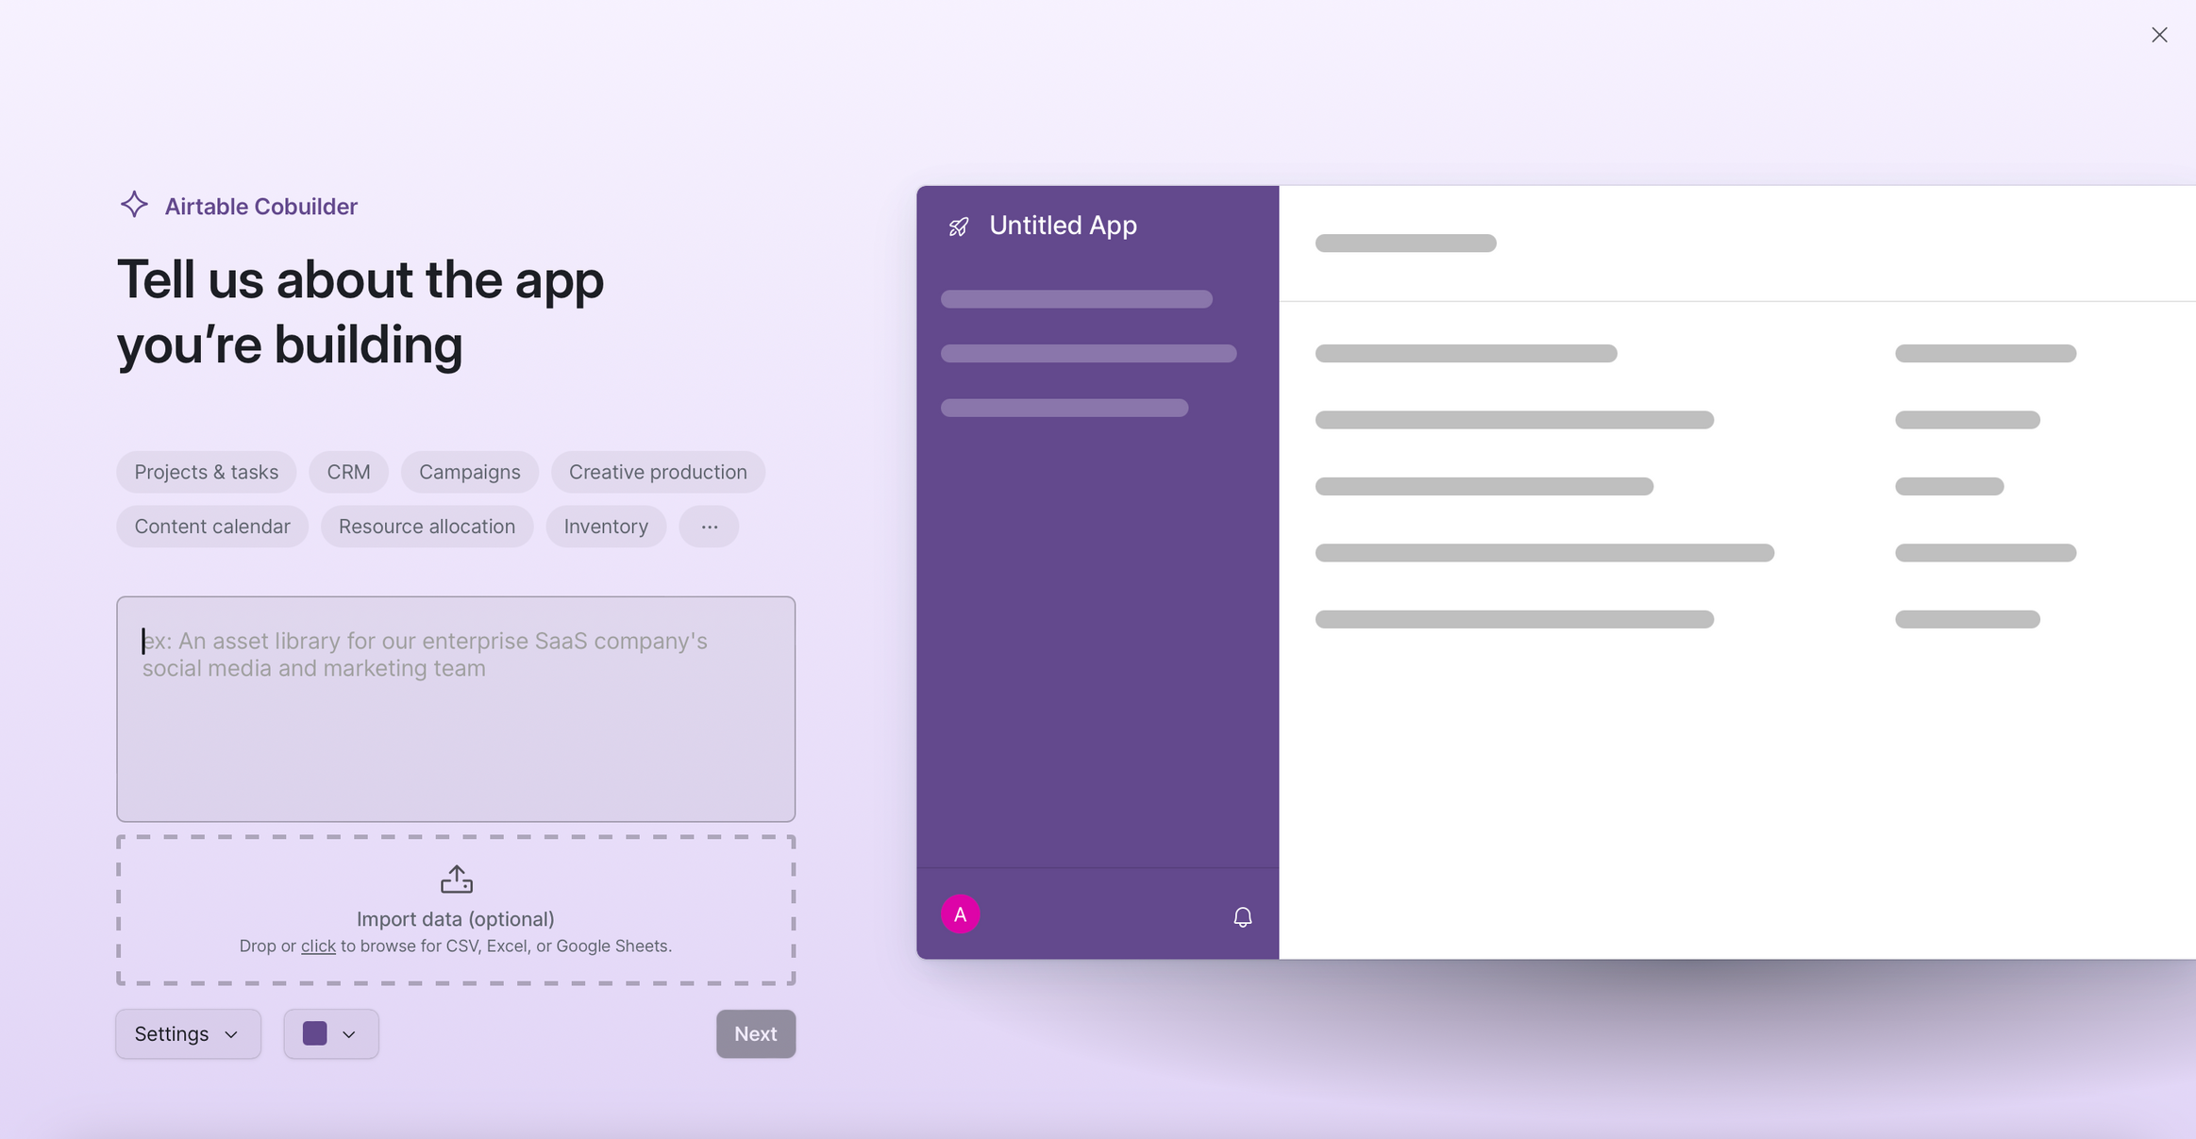

Slide 31
Glide is a completely no-code platform that makes it possible to create mobile applications crawling directly from Google Sheets. It is able to take data from the spreadsheets and animate it into applications through an easy, drag-and-drop setting. Applications, like inventory management, directories, or project work tracking, can be created with glide. Also very good for every person who is not technically savvy and just wants a streamlined process to create superior, functional mobile applications almost instantly, without a single line of code.
GLIDE

Slide 32
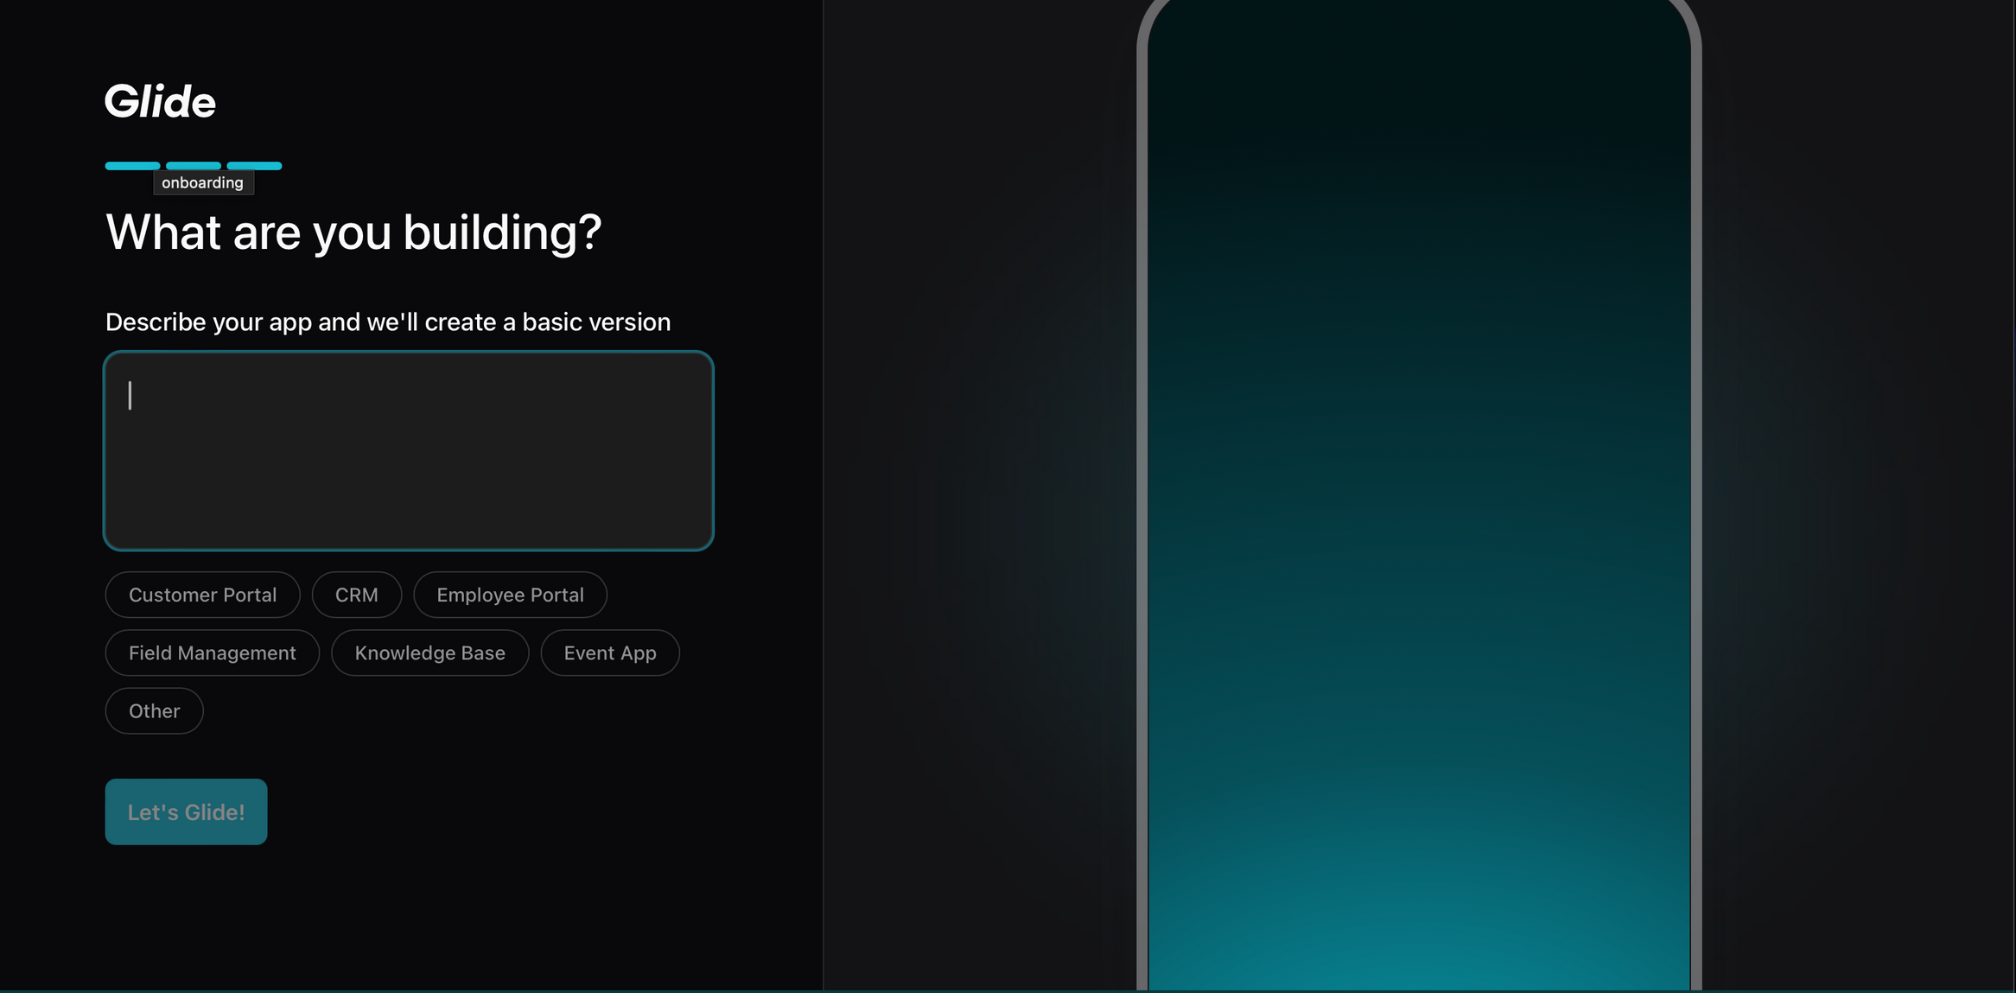

Slide 33
It is an online e-commerce platform that lets you build, manage and scale an online store without any technical know-how. It features a user-friendly interface along with the various customizable templates with payment gateway integrations and automates the inventory. Besides, it facilitates product posting, order tracking, shipping, and customer management which round it up as a good solution to businesses within any size. It provides marketing tools, search engine optimization features, and app integrations that enhance the functionality of a store. Shopify is preferred by those companies and entrepreneurs who want to sell their products online in as few possible steps as can be done.
SHOPIFY

Slide 34
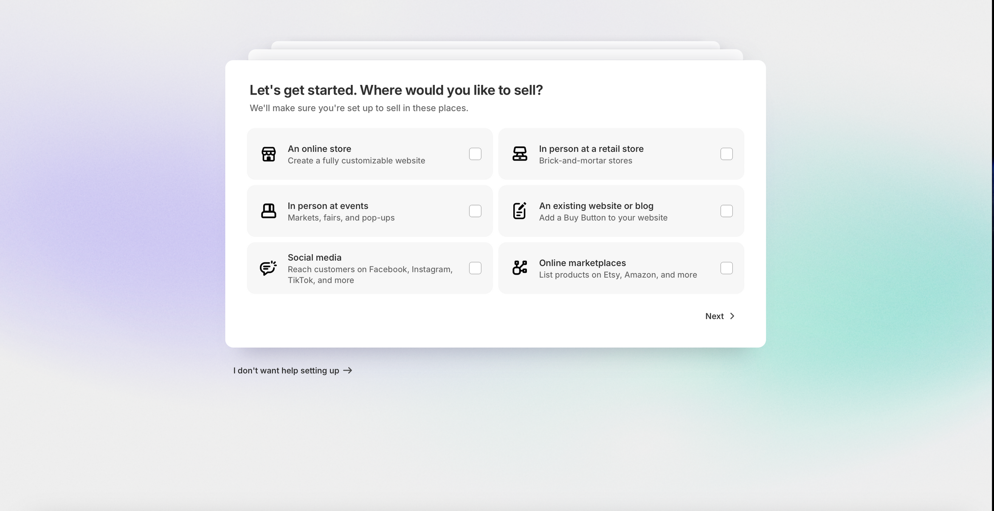

Slide 35
Adalo is a no-code platform which provides a way for users to build entirely mobile and web applications without any writing code. It presents a drag-and-drop interface to shape and customize an application visually. The no-code platform comes with built-in facilities such as user authentication, databases, and third-party services integration, thus making the building of very fast apps perfect user experience. Users can create prototypes that are interactive, create fully functional apps, and even publish such apps on either the App Store or Google Play. Thus, Adalo is suitable for entrepreneurs, start-ups, and enterprises that wish to develop apps without their own development team.
ADALO

Slide 36
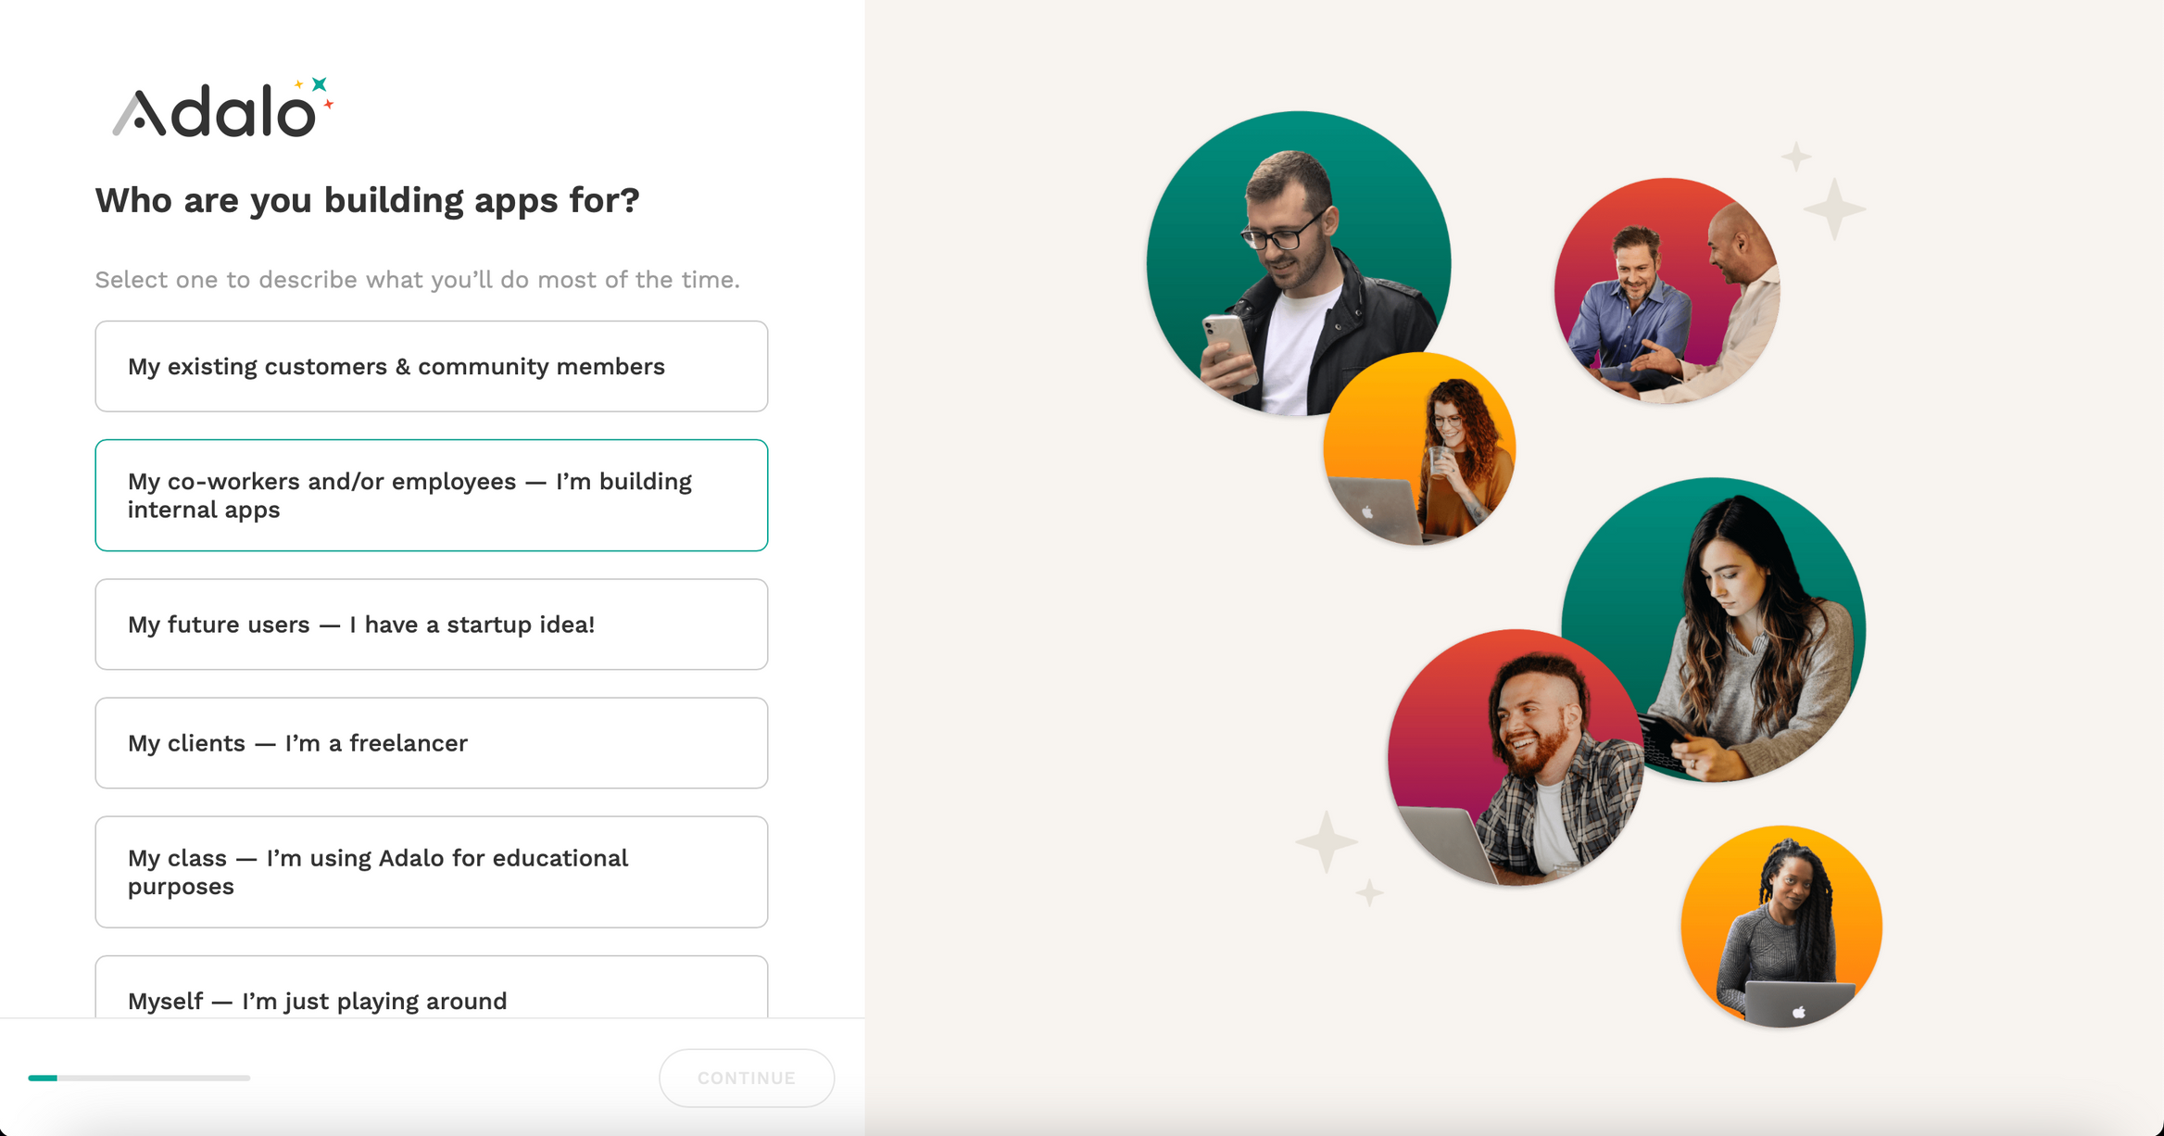

Slide 37
It is a no-coding-required platform for interactive database visualization and chart-making. The service gives end users the power to create graphs, dashboards, and reports from their data without any programming knowledge. A simple drag-and-drop interface allows users to import data from different sources and build charts, graphs, and many more visual elements quickly. Grapher is most often used for business analytics-from data presentations and reporting to creating customized views and functionalities-the latter being supported so that users can build their visualizations according to specified needs that are also quite accessible by a non-technical audience.
GRAPHER

Slide 38
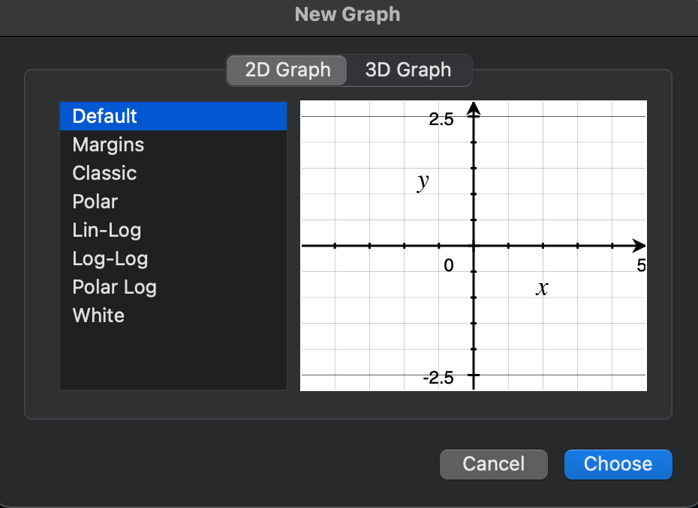

Slide 39
Thank You

